Slide 1
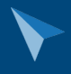
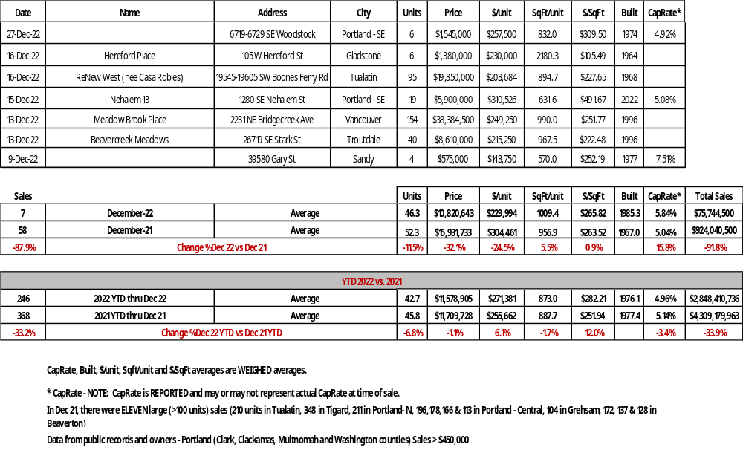

Portland Metro Multifamily Sales: Dec 22
Sales >$450K in Multnomah (OR), Washington (OR), Clackamas (OR) and Clark (WA) counties
NOVEMBER 2016
Steve Morris / SMI Commercial Real Estate/ steve@smire.com / (503) 970-4593

